Slide 1
PROJECT DOORSTEP
Calgary
Office Visit - May 9-12, 2000
Reported- May 24, 2000
Confidential

Slide 2
Project Doorstep-Calgary
Review Highlights
Project Objective:
We performed an on-site review of processes, procedures and controls that support the trading and origination business activities within the Calgary office. Our procedures included interviews with key commercial and accounting personnel. We also performed a test of commodity transactions from deal execution through settlement.
Team Members: Office Personnel Interviewed:
Sally Beck - Vice President - Operations Rob Milnthorp - President & CEO
Scott Earnest - Risk Management Jon McKay - Trader
Vladimir Gorny - RAC Peggy Hedstrom - VP of Energy Operations
Tom Bauer - AA Laura Scott - Sr. Director of Acctg & Rptg
Jennifer Stevenson - AA Peter Keohane - Asst. General Counsel
Sean Kiehne - AA Bill Greenizan - Power Trader
Kyle Kitagawa - Vice President - Finance
Derek Davies - Director - Originations
Kathy Reeves - Risk Management
Scott Adams - Risk Management
John Disturnal - Options Trader

Slide 3
Project Doorstep-Calgary
Current Portfolio
Gas
Longest physical positions are with three Canadian producers
(PetroCanada, Canadian Natural Resources, Tarragon) totaling
approximately 170 Bcf long through October 2014.
Long term transportation positions (tolls) currently exist on Nova,
Foothills, Northern Border, TransCanada, Alberta Natural Gas, and
Pacific Gas Transmission pipelines aggregating to approximately 13Bcf long extending through October 2014.
The portfolio consists of 13 natural gas basis options (Aeco, Sumas, NYMEX) with a MTM value of approximately $1 million with the longest term extending through October 2001.
Approximately 50% of Enron Corp’s. uncollateralized MTM exposure is derived from existing exposures from Canadian counterparties totaling approximately $220 million as of 4/17/00.
April 2000
NOP long 2.9Bcf
V@R $2.7 M
*DEAL TEST - Tested 11 deals (4 financial)

Slide 4
Project Doorstep-Calgary
Current Portfolio
Power
3 financial power swaps make up the entire power portfolio.
These swaps are fixed for float swaps with TransAlta (2) and
Duke (1).
Approximately 10 financial swaps have been executed since January
1999.
May 10, 2000
NOP long 86,000 MWh
MTM value $1.3 MM
*DEAL TEST - Tested 3 deals (all financial)
Other
Crude oil swaps represent 1% of the total trading portfolio.
Three fixed for float swaps, 2 swaps (ONP8) with Papier Masson and 1 swap (NBSK) with Irving Pulp & Paper.
Investment portfolio consists of 5 public equity investments (Beau Canada Exploration, Place Resources, Startech Energy, Cypress Energy, CNR - warrants), 2 private equity investments (Invasion Energy Inc. and Papier Masson Ltee) and 1 public debt investment (Invasion Energy).
*DEAL TEST - 1 NBSK & 1 ONP8 SWAP

Slide 5
Project Doorstep - Calgary
Observations
EFFECTIVE CONTROLS
Key mid-office and back-office management are experienced and familiar with Enron procedures
The Assistant General Counsel is knowledgeable about key commercial aspects (market structure, market risk, transactions)
Commercial personnel have an adequate understanding of overall Enron processes and required protocols
Top commercial and commercial support personnel have an appropriate assessment of operational risk and are knowledgeable about their roles within the controls process

Slide 6
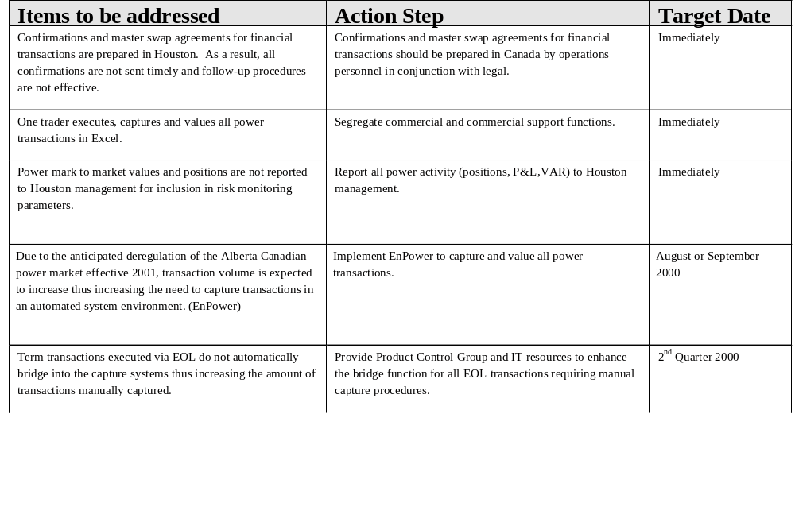
Project Doorstep - Calgary Observations

Slide 7
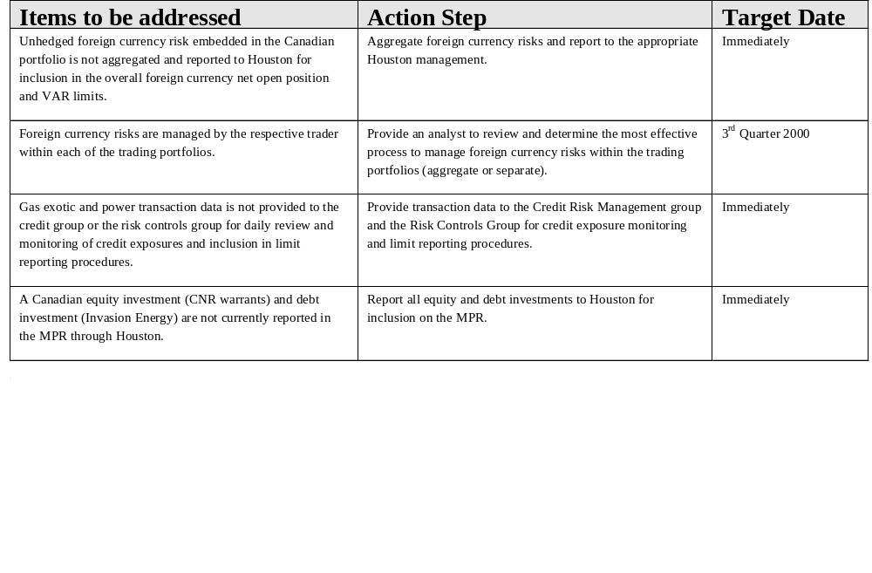
Project Doorstep - Calgary Observations

Slide 8
Project Doorstep - Calgary
Deal Test Attributes
Key attributes tested - Tested 18 deals (11 gas, 3 power, 2 paper, 1 oil, 1 foreign currency)
Deal Capture
  Authorized trader
  Complete deal ticket
  Deal correctly booked in capture system (TAGG, Sitara, Excel)
Documentation
  Confirmation creation date
  Time taken to create contract since trade date
  Executed contract and/or confirmation
  Contract, confirmation and deal ticket agree
Logistics
  Proper nomination
Settlement
  Invoice agrees to contract
  Authorized disbursement
  Evidence of cash paid or received

Slide 9
Project Doorstep - Calgary
Deal Test Findings
Summary of test findings
Confirmations for two financial transactions that were originated approximately 8 - 10 months ago were not executed at the time of our review. In addition, all confirmations and master swap agreements for financial transactions are not provided to Canada by Houston after counterparty execution. (Houston performed process)
Power transactions are not reported in the DPR.
The ISDA Master Agreement date referenced in the confirmation did not agree with the date of the ISDA Master Agreement for one paper transaction. (Houston performed process)

Slide 10
Project Doorstep - Calgary
Observations
AREAS FOR FURTHER REVIEW
Adequate system infrastructure support for increase in transactional data and valuable management reports (TAGG, Sitara).
Assessment of the need for additional back office support personnel in the risk management area.
OUTLOOK
It is expected that options trading activity would increase with the addition of an analyst. Additional focus may be needed for increased back office support.
Power activity is expected to increase in Alberta with the deregulation of the wholesale market and the successful negotiation of PPAs.
The Toronto office is expected to generate trading activity once deregulation of the wholesale electricity market occurs.

Slide 11
Project Doorstep - Calgary
Office Analysis Framework
Market Structure
Concentration of producers in Western Canada
Mature gas trading environment
Illiquid wholesale power pool in Alberta
Wholesale deregulation anticipated for Toronto and Alberta (January 2001)
Opportunity for capital activity through equity or debt investments in oil & gas companies
Management
Recent change in office leadership
Some traders with limited experience
Key management have extensive knowledge of Enron
Limited experienced power resources
Systems
TAGG and Sitara (gas trading)
Solomon (accounting)
Unify (physical settlements)
Excel (power trading)
NGX (screen trading)
EnronOnline (screen trading)
Information
Daily position reports
Various management reports

Slide 12
Project Doorstep - Calgary
Office Analysis Framework
Strategy
Anticipated growth in Toronto office as a result of deregulation in wholesale electricity
Increase in options trading
Counterparties
Primarily producers and other marketers for gas
Competitors
Enron has a strong presence in the physical gas market
Financial institutions such as CIBC, Sempra/AIG and Morgan Stanley for financial transactions
Very few players in the electricity market
Business Processes
Back-office accounting coordination between Houston and Calgary
Documentation procedures for financial transactions conducted by Houston (confirms, ISDAs)
Credit approval in Houston
Power scheduling in Portland for real time
Other mid and back-office functions in Calgary

